Slide 1
Data Collection
Kurt Burgess

Slide 2
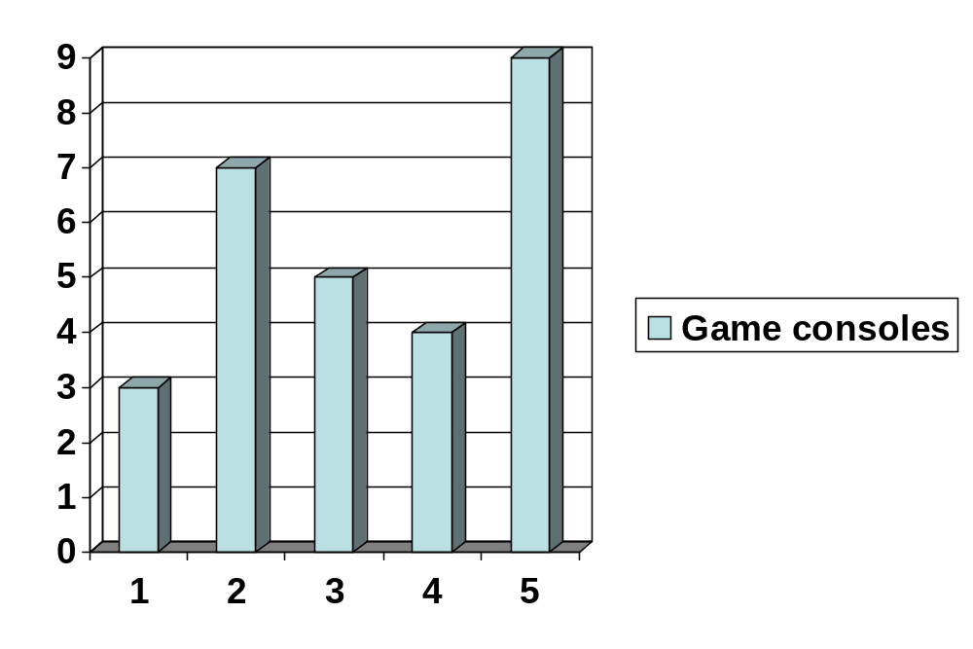
How many game consoles do you have?

Slide 3
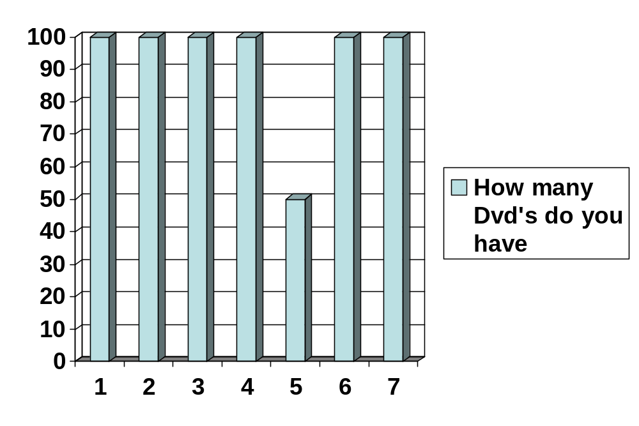
How many Dvd’s do you have?

Slide 4
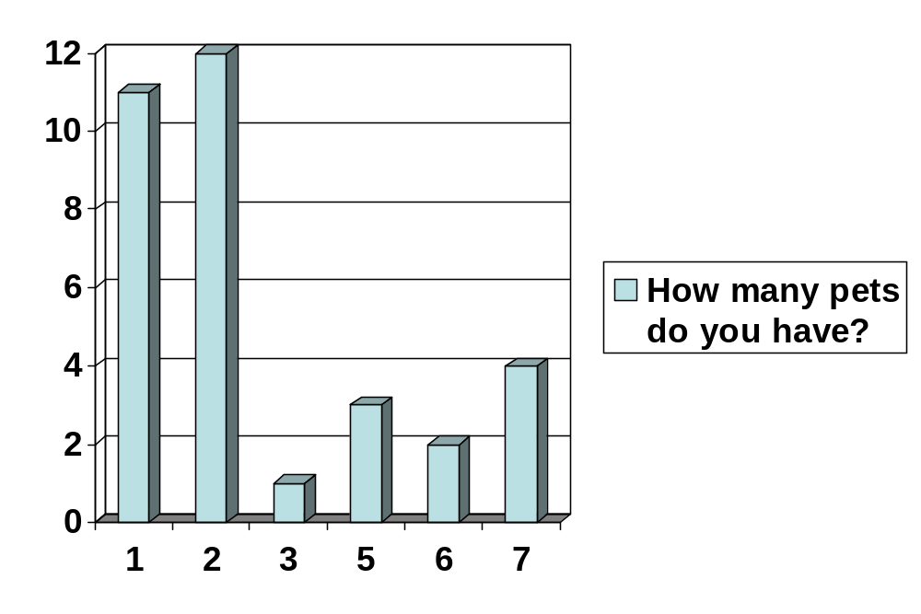
How many pets do you have?

Slide 5
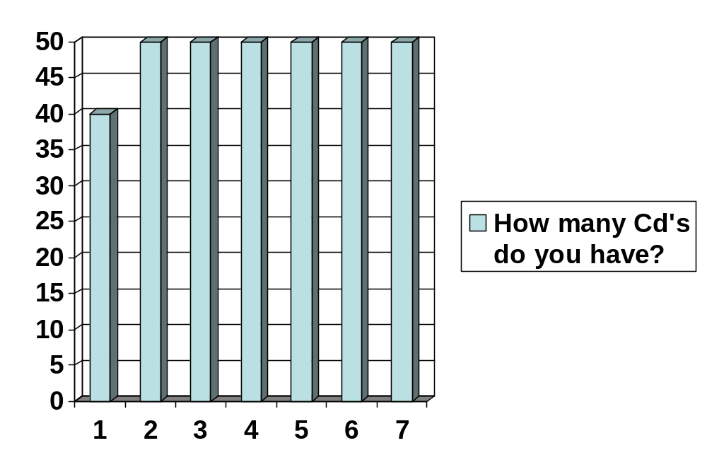
How many Cd’s do you have?

Slide 6
Do you like chocolate?
8/10 people like chocolate.

